Slide 1

Introduction to Cybersecurity (GREAT LEARNING) https://github.com/payalbajantri/internship
Department of Computer Science
and Engineering- Data Science
Name of Student = Payal Bajantri
PRN No = 202401120064
Branch = DATA SCIENCE
Name of Guide =
2025-2026

Slide 2
Introduction / Background of Internship
Department of Computer Science
and Engineering- Data Science
The Importance of Cybersecurity: The course provided an in-depth look into the critical field of cybersecurity, which is essential for protecting digital systems and data in today's world.
Course Focus: The curriculum was designed to build a strong foundation, covering everything from core principles to practical threat analysis and defense mechanisms.
Goal: My main objective was to gain the skills needed to identify vulnerabilities and respond effectively to cyber threats.

Slide 3
Objectives of Internship
Department of Computer Science
and Engineering- Data Science
Fundamental Concepts: To master the core principles of cybersecurity, including the CIA Triad (Confidentiality, Integrity, and Availability).
Threat Identification: To identify and analyze common attacks such as ransomware, phishing, and botnets.
Cryptographic Knowledge: To understand the role of cryptography in ensuring data security and privacy.
Proactive Security: To learn how to apply a security-first mindset in system design and development.

Slide 4
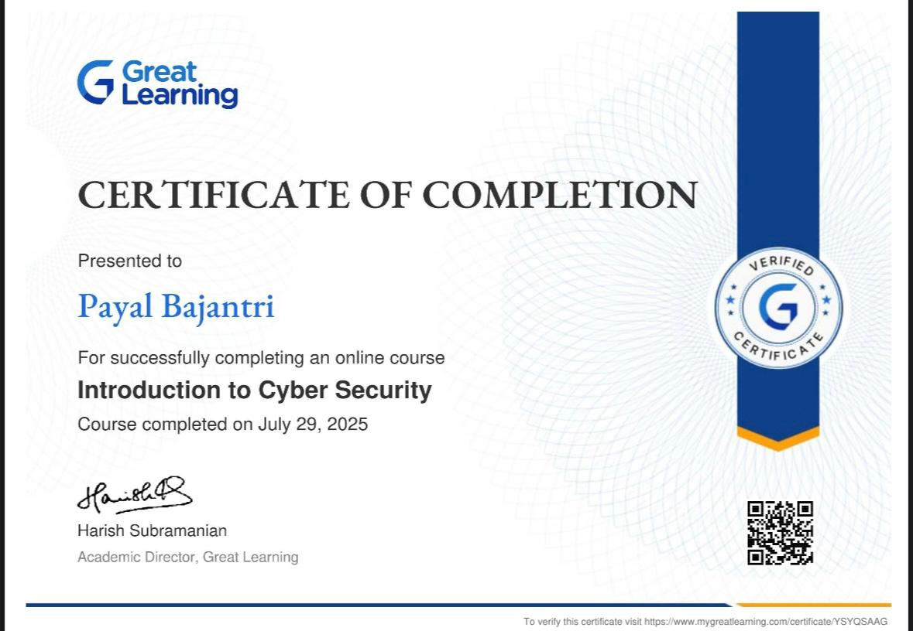
Company Overview / Certification Overview
Department of Computer Science
and Engineering- Data Science

Slide 5
Task/ Assignment Competed
Department of Computer Science
and Engineering- Data Science
Analyzed the motivations and life cycle of a cyber attacker.
Classified different types of malware, such as ransomware
and botnets.
Explained the principles of symmetric and public-key
cryptography.
Completed all course quizzes and thoroughly reviewed notes to
reinforce key concepts.
Conducted a detailed case study on the WhatsApp hack
to understand
a real-world vulnerability and its prevention.

Slide 6
Skills Learned & Tools Used
Department of Computer Science
and Engineering- Data Science
Threat Intelligence
Cryptography
Secure Coding Principles
Problem-Solving and Critical Thinking

Slide 7
Challenges Faced & Solutions
Department of Computer Science
and Engineering- Data Science
Challenge: The most significant challenge was grasping the
complex mathematical concepts behind cryptography.
Solution: I overcame this by doing extra research, reviewing course materials, and practicing with practical examples to build a strong conceptual foundation.

Slide 8
Key Achievements & Outcomes
Department of Computer Science
and Engineering- Data Science
Comprehensive Knowledge: Gained a solid understanding
of cybersecurity principles.
Real-World Application: Applied theoretical knowledge to
analyze and learn from a real-world hack.
Skill Development: Developed a proactive and analytical
mindset that is essential for a career in cybersecurity.

Slide 9
Conclusion & Future Scope
Department of Computer Science
and Engineering- Data Science
Conclusion: The course provided a crucial and
comprehensive introduction to cybersecurity, solidifying my interest in the field.
Future Scope: I plan to build upon this foundation by
specializing in a specific area, such as network security or ethical hacking.

Slide 10
Acknowledgements/References
Department of Computer Science
and Engineering- Data Science
Finally, I am grateful to GREAT LEARNING for providing this enriching opportunity.

Slide 11
Questions
Department of Computer Science
and Engineering- Data Science

Slide 12
Thank You
Department of Computer Science
and Engineering- Data Science

